Slide 1
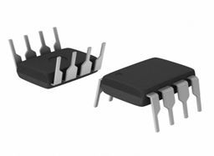
Rmae presentation
IC 555 TIMER AND ITS APPLICATIONS
GROUP I6: division I
ASHISH KAPASE(30)
SAHIL KAPASE(31)
KAPIL SANGAMESHWAR(32)
VED KAPRE(33)
BHAKTI KAPSE(34)
YOGITA KAPSE(35)

Slide 2
Contents:
Introduction
Block Diagram of IC 555
Explanation of the Block Diagram
Modes:
Monostable
Bistable
Astable
Applications-
LED lamp dimmer
Logic problem with pulse
Wave form and Square wave generation
Burglar alarm
Tilt switch
Metronome
Advantages
Disadvantages
References

Slide 3
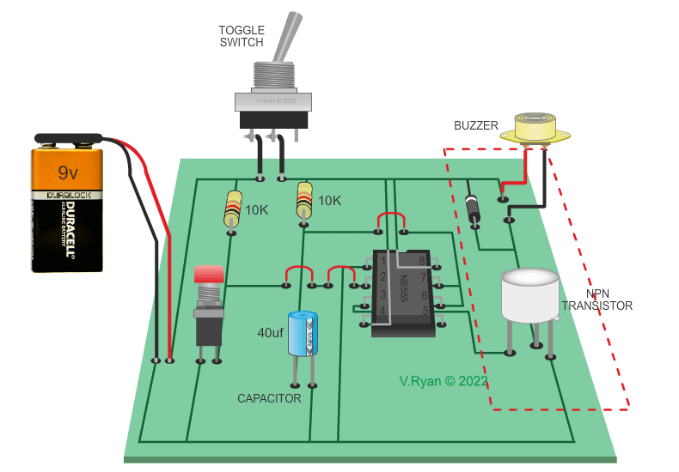
INTRODUCTION-
555 Timer was developed by an electronic
engineer Hans Camezind in 1971.
555 timer is a digital monolithic integrated
circuit which may be used as clock generator
or monostable multivibrator.
The timer takes its name from the fact that
the original model packed 3 resistors, rated
at 5k ohm each.

Slide 4
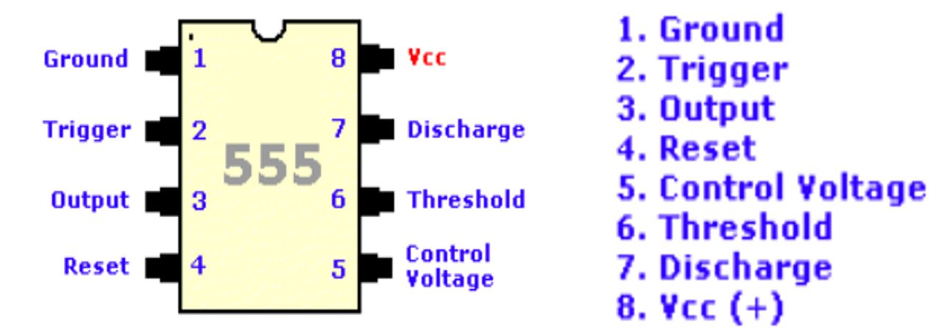
Ground: Acts as a safety measure similar to plugs for wall outlets.
Trigger: Passes on voltage to start timing operations.
Output: Carries voltage to the device using the timer.
Reset: Ends the timing operation.
Control voltage: An optional pin for controlling the circuit outside the main setup.
Threshold: Determines how long the timer should output voltages during each ON/OFF cycle.
Discharge: It’s connected to capacitor, also influences the timing interval.
Vcc: Inputs voltage

Slide 5
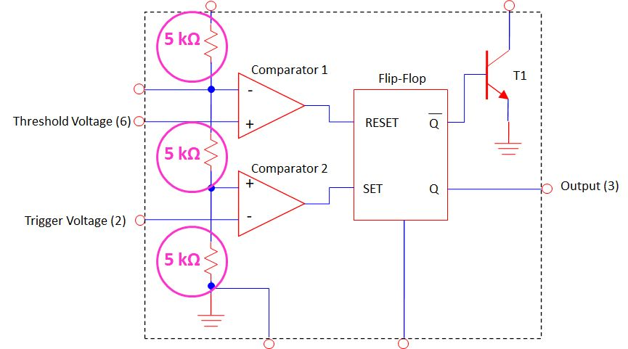
Block diagram of ic 555

Slide 6
Inside the ic 555 timer
The voltage divider (pink) has three equal 5k resistor. It divides the input voltage (Vcc) into three equal parts.
The two comparator (brown) are operational amplifier (voltage amplifier) that compare the voltage at their input and saturate upon which is greater.
The threshold comparators saturates when the voltage at the Threshold pin (pin 6) is greater than (2/3) Vcc.
The trigger comparator saturates when the voltage at the Trigger pin (pin2) is less than (1/3) Vcc.

Slide 7
The flip-flop is a bi-stable device. It generates two values , a “high value= Vcc , low value=0V”.
When the Threshold comparator saturates , the flip-flop is Reset ® and it outputs a low signal at pin 3.
When the Trigger comparator saturates, the flip-flop is set (s) and it output a high signal at pin 3.
The transistor is being used as a switch ,it connects pin 7(discharge) to ground when it is closed.
When Q is low , Q is high. This closes the transistor switch and attaches pin 7 to ground .
When Q is high , Q is low. This open the transistor switch and attaches pin 7 is no longer grounded.

Slide 8
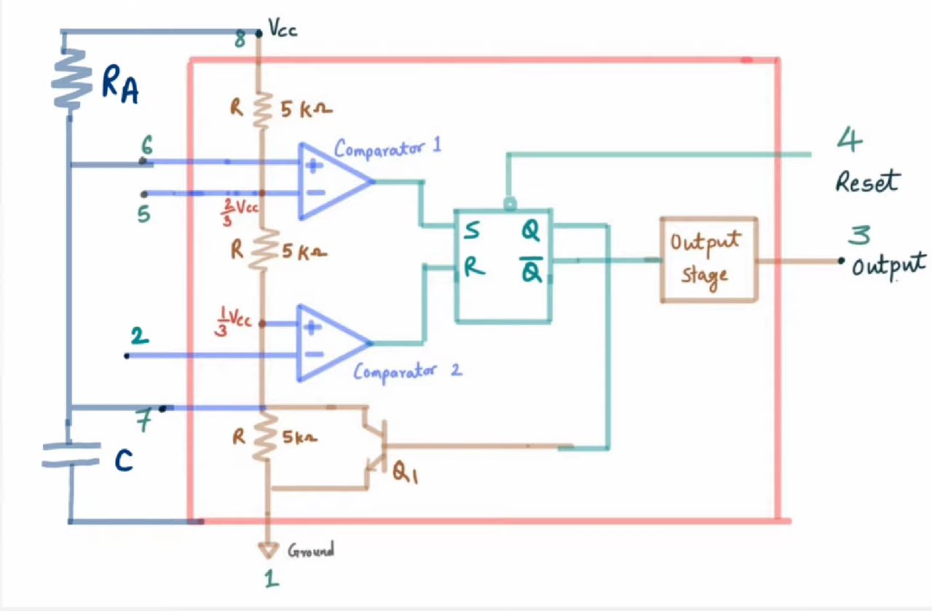
MONOSTABLE MULTIVIBRATOR

Slide 9
The circuit has only one stable state. When trigger is applied, it produces a pulse at the output and returns back to its stable state. As it has only one stable state, it is called monostable multivibrator.
The flip-flop is initially set i.e. Q is high. This drives the transistor in saturation. The capacitor discharges completely and voltage across it is nearly zero. The output at pin 3 is low.
When a trigger input, a low going pulse is applied, then circuit state remains unchanged till trigger voltage is greater than 1/3 VCC.
When it becomes less than 1/3 VCC, then comparator 2 output goes high. This resets the flip-flop so Q goes low and Q̅ goes high. Low Q makes the transistor off.

Slide 10
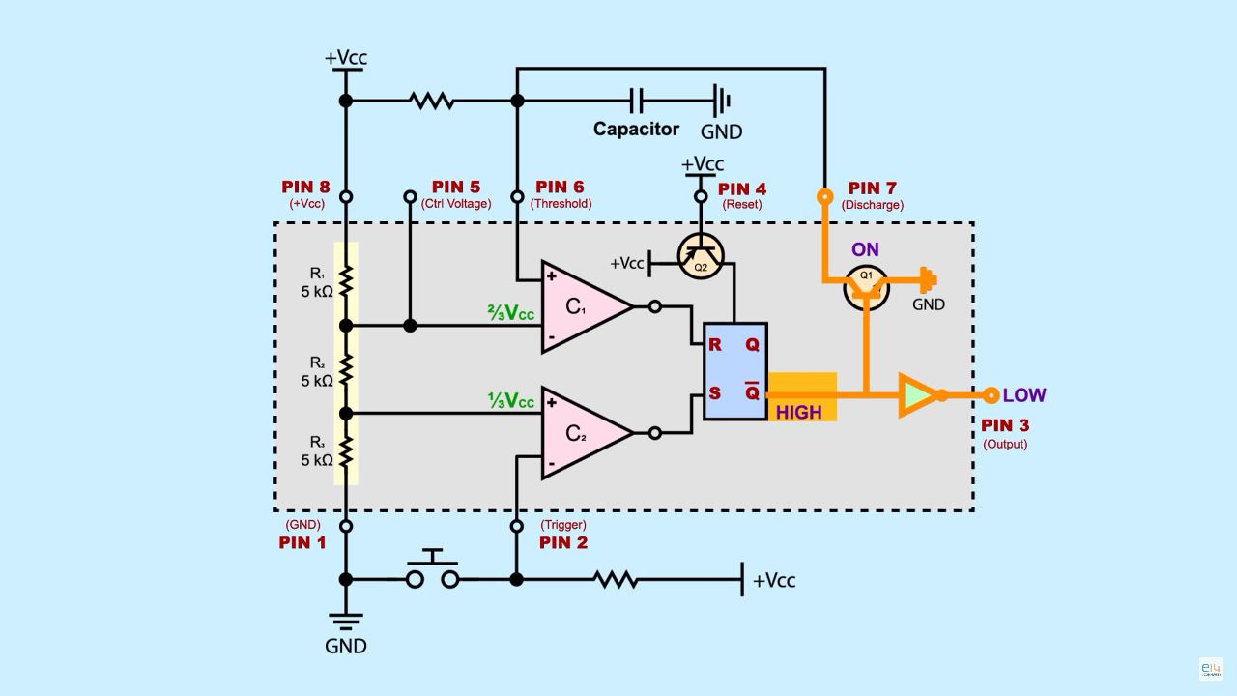
BISTABLE MULTIVIBRATOR
A Bistable multivibrator is a type of circuit which has two stable states (high and low).
A Bistable multivibrator stays low until a trigger signal is applied and it stays high until a reset signal is applied.
Bistable multi vibrators are also called as flip-flops or latches. The term flip-flop is used because it ‘flips’ to one state and stays there until a trigger is applied and once the trigger is applied it ‘flops’ back to the original state.
It doesn’t require a capacitor as the RC charging unit is not responsible for the generation of the output.

Slide 11
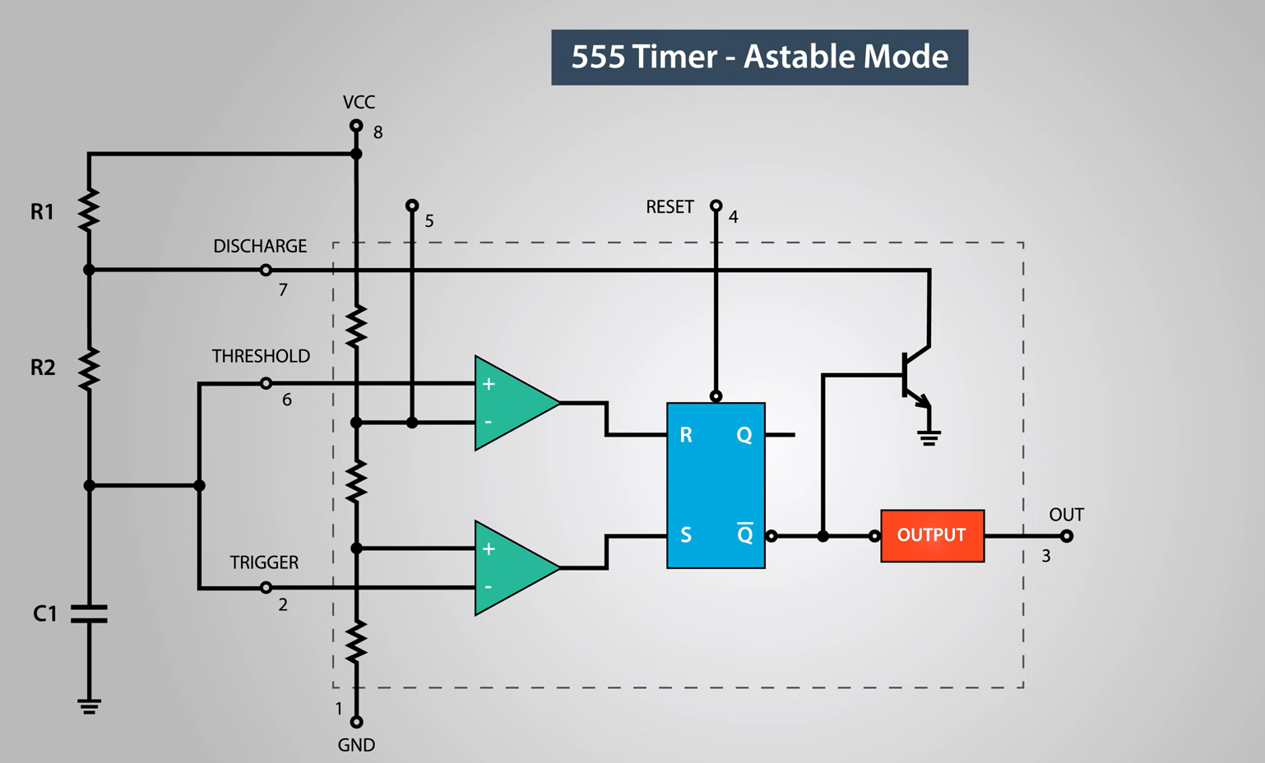

Slide 12
Applications

Slide 13
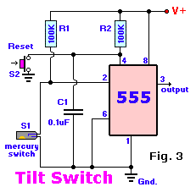
Tilt Switch
The switch is mounted in its normal 'open' position, which allows the timer output to stay low, as established by C1 on start-up.
When S1 is disturbed, causing its contacts to be bridged by the mercury blob, the 555 latch is set to a high output level where it will stay even if the switch is returned to its starting position.
The high output can be used to enable an alarm of the visual or the audible type.
Switch S2 will silent the alarm and reset the latch.
Used in Video Cameras, Aircraft Flight Controls, Construction Equipment, Robotic Technology.

Slide 14
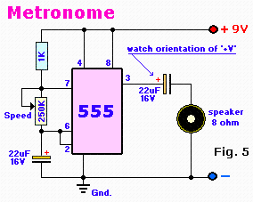
Metronome
Metronome is popular as a synchronizing tool for musicians through which they can match the tempo of their beats.
This project about metronome circuit uses a 555 in astable mode with a variable resistor between pin7 and VCC .
It generates a continuous output via Pin 3 in the form of a square wave.
This is then passed through the 22microF electrolytic capacitor to create a smooth oscillation which then creates the 'toc-toc' sound.
The speed of the output is controlled by the 250K Potentiometer

Slide 15
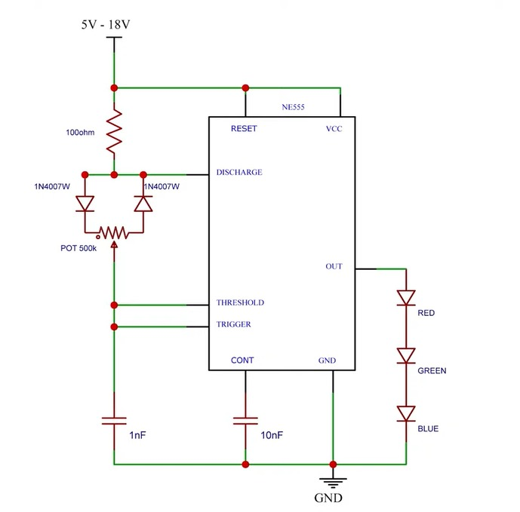
LED Lamp Dimmer
Acts as free running oscillator Generates square wave continuously Controls Brightness of LED using PWM technique.
Drives LED with series of ON-OFF pulses Varying the Duty Cycle affects the intensity of light.
DUTY CYCLE: time the pulse is on compared to pulse is off, keeping frequency constant.
Change in this on-off timing results in change in brightness.

Slide 16
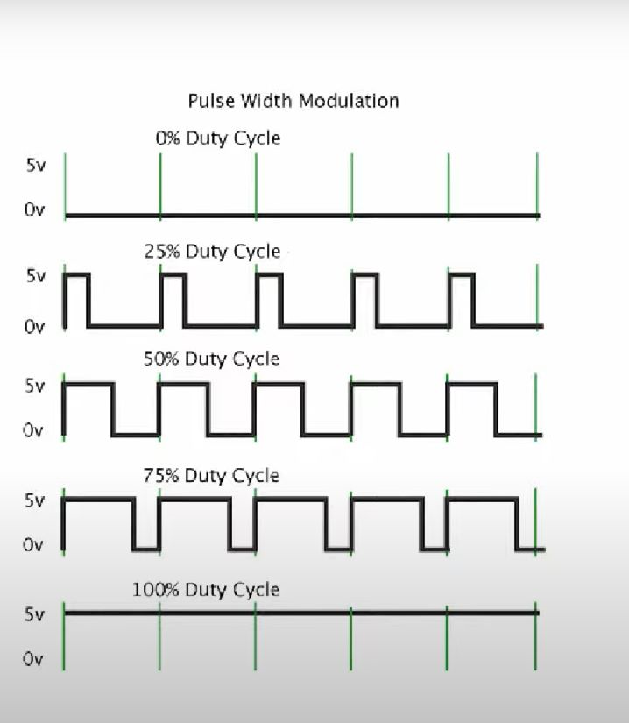
PWM(Pulse width modulation): Pulse-width modulation, or pulse-duration modulation, is a method of reducing the average power delivered by an electrical signal, by effectively chopping it up into discrete parts.
The average value of voltage fed to the load is controlled by turning the switch between supply and load on and off at a fast rate.
DUTY CYCLE: A duty cycle or power cycle is the fraction of one period in which a signal or system is active.
Duty cycle is commonly expressed as a percentage or a ratio.
A period is the time it takes for a signal to complete an on-and-off cycle

Slide 17
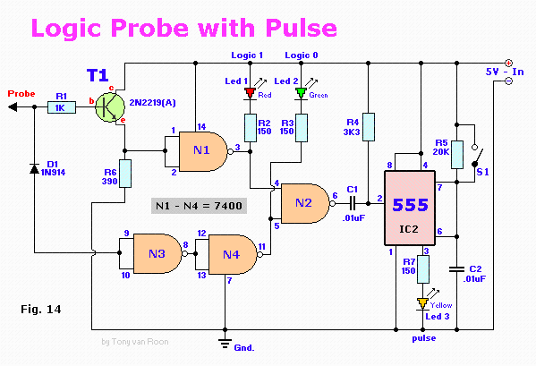
pulse Generation
IC555 timer is an integrated circuit used for timer ,pulse ,many other application.
The high-voltage supply and the pulse generator use a circuit where capacitors are charged in parallel from a low-voltage source such as a 12-V battery, then discharged in series to gain a voltage multiplication and produce a high-voltage pulse.
By connecting pin 2 and 6 we put the 555 timer in astable mode. Astable mode causes the 555 timer to re-trigger itself, producing a stream of pulses [PWM Signals] as long as its hooked up to a power supply.
The maximum output current of this IC is 200mA therefore to drive a higher current load of up to 1A we have to use a transistor like the BD135.

Slide 18
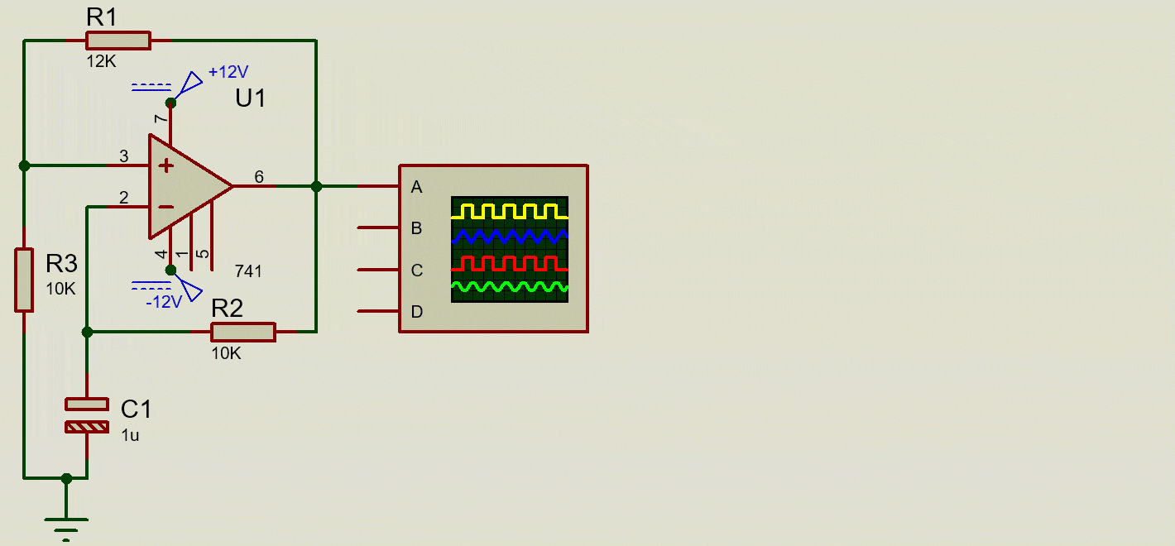
Waveform, and square wave generation

Slide 19
A square wave is a non sinusoidal periodic waveform in which the amplitude alternates at a steady frequency between fixed minimum and maximum values, with the duration.
In an ideal square wave, the transitions between minimum and maximum are instantaneous.
A pair of cross-coupled emitter transistors produces the square wave output of an astable multivibrator.
As a common emitter amplifier in the multivibrator, both transistors, NPN and PNP, have a bias for the linear operation leads to this wave generation

Slide 20
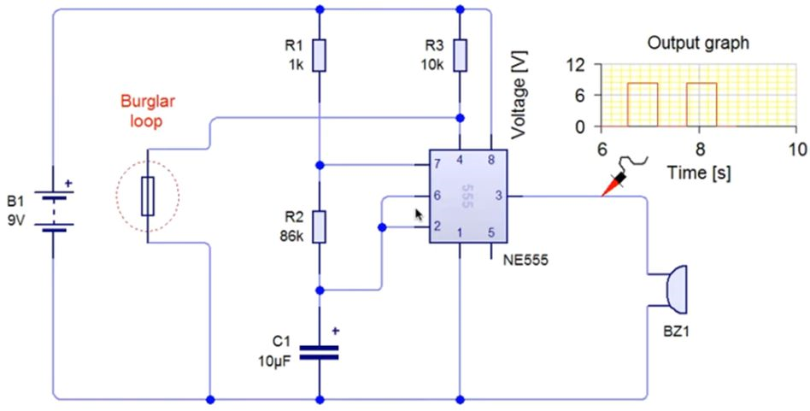
Burglar alarm

Slide 21
When supply is connected to the circuit, keeping the loop-wire intact, pin-4 of the IC remains grounded. So the IC is disabled and its output remains LOW. So the speaker remains silent and this condition remains as it is till the loop-wire is broken. The moment the loop-wire is broken, pin-4 of the IC is returned to positive potential and the IC comes in action.
Now capacitor C1 starts charging through series resistors R1 and R2 and discharging through R2 only. Due to this, a high frequency signal i.e. square wave (about 1.5kHz) is produced at output pin-3 of the IC. The output contains DC component also. So a decoupling capacitor C3 filters out the unwanted DC component and only the square wave signal is connected to the speaker. So the speaker produces a shrill whistle like alarming sound. The high frequency sound is produced because we are using the IC 555 as Astable Multivibrator

Slide 22
Advantages and disadvantages of ic 555
ADVANTAGES
It operate from a wide range of power supplies from +5v to+18v supply voltage.
Sinking or sourcing 200mA of load current .
The external component should be selected properly.
It has high current output; The output can drive TTL
It has temperature stability of 0.005%/ degree celcius6) The duty cycle of timer is adjustable with the maximum power dissipation per package is 600mV and its trigger and reset inputs are logic compatible.

Slide 23
DISADVANTAGES
The integrated circuit (IC) can be handle only limited amount of power.
The high grade P-N-P assembly is not possible.
It is difficult to be achieved low temperature coefficient.
The coils or indicators cannot be fabricated.
Low noise and high voltage operation are not easily obtained.
Inductors and transformers are needed connecting to exterior to the semiconductor chip, as it is not possible to fabricate inductor and transformers on the semiconductor chip surface.
The power dissipation is limited to 10 wattsThe inductors cannot be fabricated directly.

Slide 24
Some other applications of ic 555
PWM (Pulse Width Modulation) & PPM (Pulse Position Modulation)
Duty Cycle Oscillator
To provide Accurate time delays
As a flip-flop element
Digital logic probes
Analog frequency meters
Quad Timer applications
Stepped tone & tone burst generator & linear ramp generation
Wiper speed control
Tachometers & temperature measurement
DC to DC Converters
DC Voltage Regulators
Voltage to Frequency Converter
Frequency Divider
Schmitt trigger
Cable tester
Pulse detector

Slide 25
references
https://www.me.psu.edu/cimbala/me345/Lectures/The_555_Timer_IC.pdf
https://www.electronicdesign.com/technologies/analog/article/21252714/electronic-design-the-origin-explanation-and-applications-of-triplefive-timers
https://www.electricaltechnology.org/2014/12/555-timer.html
https://www.engineersgarage.com/metronome-using-astable-mode-of-555-timer-ic/
www.555-timer-circuits.com
https://youtu.be/i0SNb__dkYI
https://youtu.be/pETIMdfyJm0

Slide 26
Thank you

